Slide 1
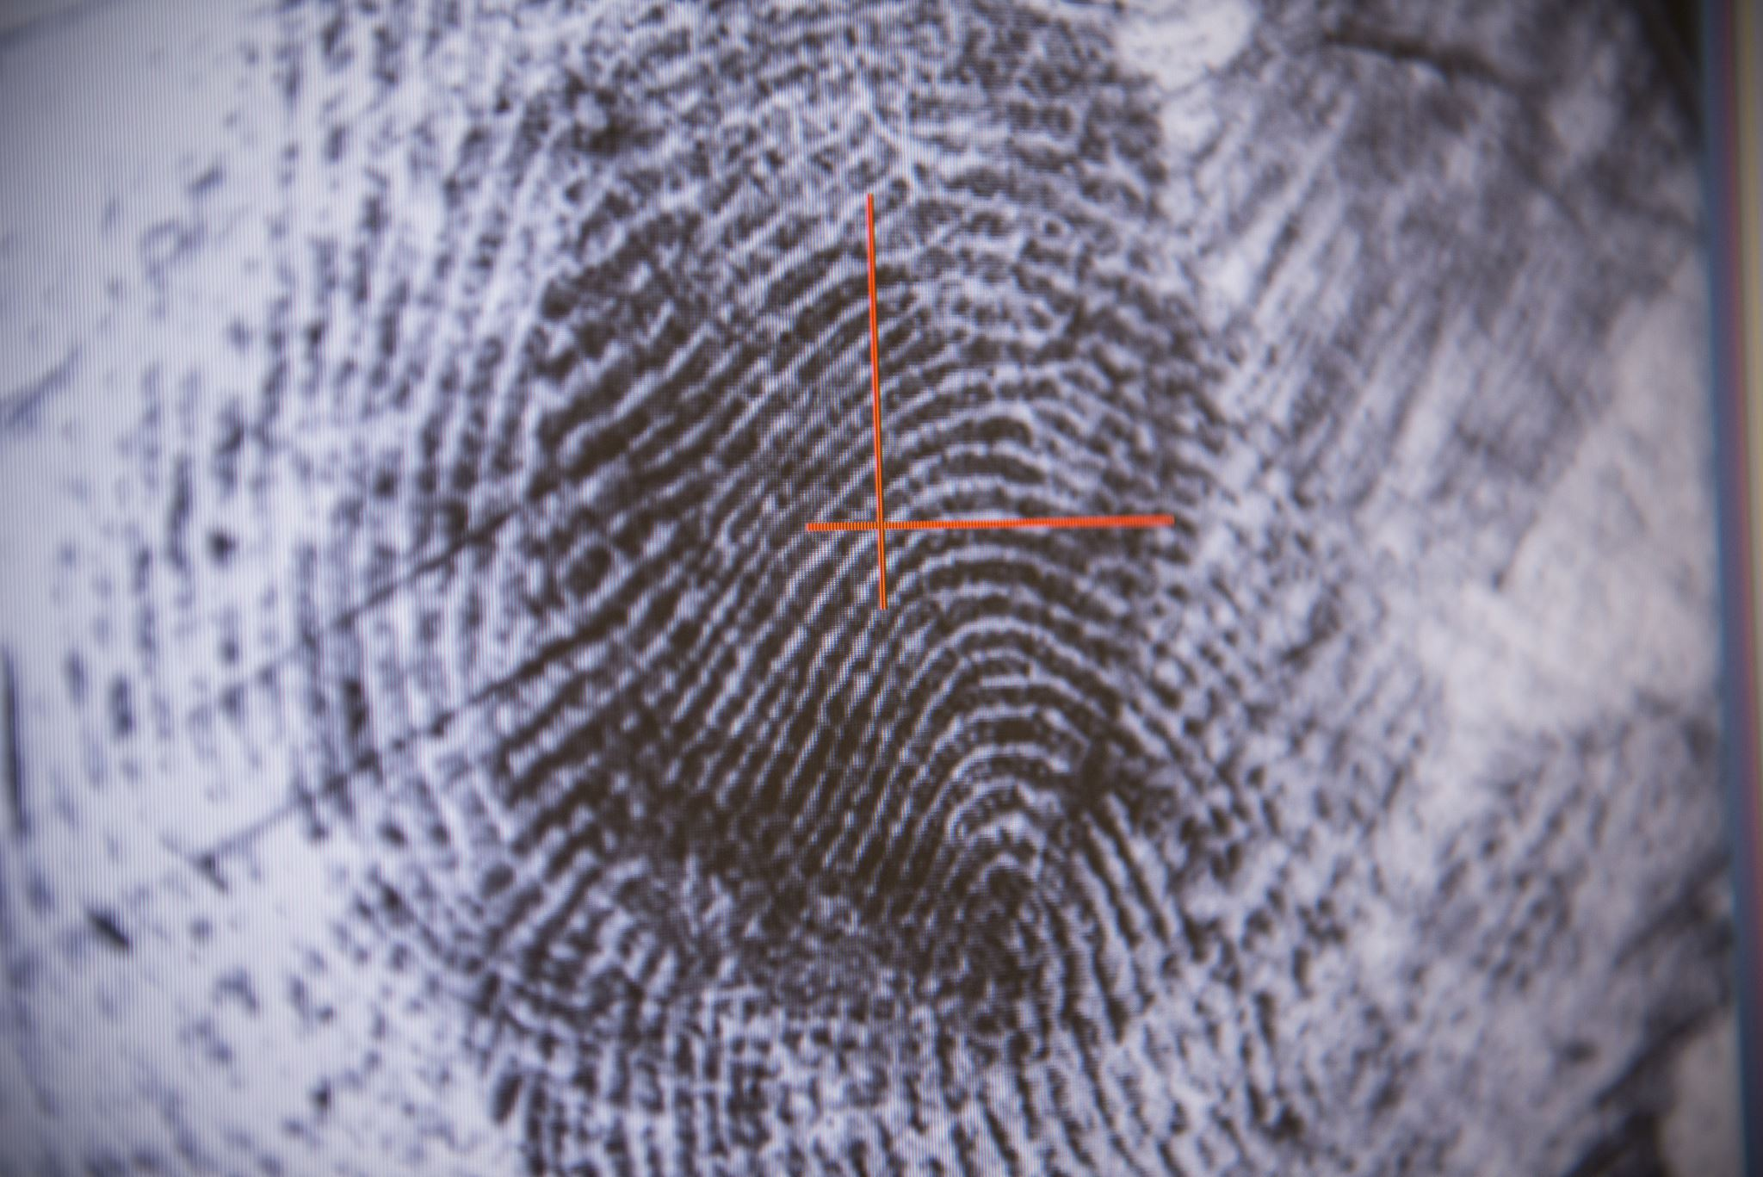

Credit Card Fraud Detection Using Autoencoder
Unsupervised Anomaly Detection Project

Slide 2
Project Overview
This project uses autoencoder neural networks to detect fraudulent credit card transactions.
The model is trained on non-fraudulent data to learn normal transaction behavior.
Fraud is identified when reconstruction error exceeds a set threshold.
Notes:
Credit card fraud is a persistent and evolving threat in the financial sector, resulting in billions of dollars in losses annually. Detecting fraudulent transactions is especially challenging due to their rarity and the constantly changing tactics employed by fraudsters. Traditional rule-based systems and supervised learning models often struggle in such scenarios because they require frequent updates and a large number of labeled fraud examples, which are scarce. To address these limitations, this project explores the use of unsupervised learning—specifically, autoencoder neural networks—to detect fraud without relying on labeled fraudulent data.

Slide 3
Dataset Summary
• 284,807 total transactions
• 492 fraud cases (0.172%) — highly imbalanced
• Features: Time, Amount, V1–V28 (PCA transformed), and Class
• Data normalized and split into training (non-fraud only) and test sets
Notes:
The credit card transaction dataset was found on Kaggle and consists of 284,807 records, however only 492 of them are marked as fraudulent and all the remaining are marked valid. Dataset contains 284,807 transactions, of which only 492 are fraudulent, representing approximately 0.172% of the data—highlighting a severe class imbalance. Each transaction is described by 30 features: 28 of these (V1 to V28) are the result of a PCA transformation applied to sensitive customer and transaction data to preserve privacy. The remaining features are Time, which records the seconds elapsed between a transaction and the first transaction in the dataset, and Amount, which represents the transaction value. The target variable, Class, is binary, where 0 indicates a legitimate transaction and 1 indicates fraud. This anonymized and imbalanced dataset presents an ideal challenge for applying anomaly detection techniques like autoencoders.

Slide 4
Data Preprocessing
Normalize time and Amount features
Checked and confirmed no missing values
Separate the features and labels
Split the dataset
Converted data to Numpy arrays
Notes:
Normalized the Time and Amount features using StandardScaler, since these were not PCA-transformed like the other features.
Checked for and confirmed no missing values across all columns, ensuring the dataset was complete.
Separated the features and labels, with X containing all input variables and y storing the target class (0 = normal, 1 = fraud).
Split the dataset to isolate normal transactions for training the autoencoder, and used both normal and fraud samples for testing.
Converted data to NumPy arrays for compatibility with the Keras autoencoder model.

Slide 5
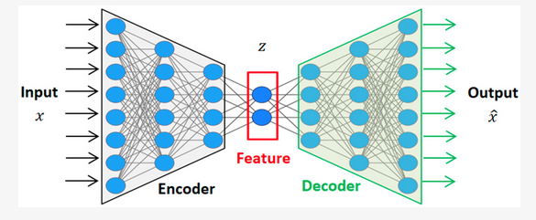
Models Architecture
Encode normal patterns into a lower dimension
Reconstruct them
Use reconstruction error to detect fraud later
Notes:
Autoencoders are a type of artificial neural network designed to learn efficient, compressed representations of data by reconstructing input from a lower-dimensional latent space. In the context of anomaly detection, an autoencoder is trained exclusively on normal (non-fraudulent) transactions to learn the typical patterns of legitimate behavior. Once trained, the model reconstructs new inputs, and those with high reconstruction error—indicating they deviate significantly from the norm—are flagged as anomalies, potentially representing fraudulent activity. This approach is particularly well-suited for highly imbalanced datasets like credit card transactions, where fraud constitutes less than 0.2% of all records.

Slide 6
Models Evaluated
1. Single-Layer Autoencoder
2. Deeper Autoencoder
3. Regularized Deeper Autoencoder (Dropout + L2)
All models trained to minimize MSE using only normal transactions.

Slide 7
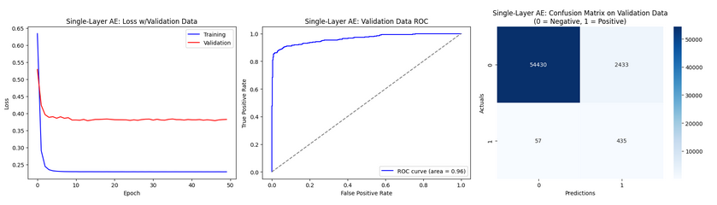
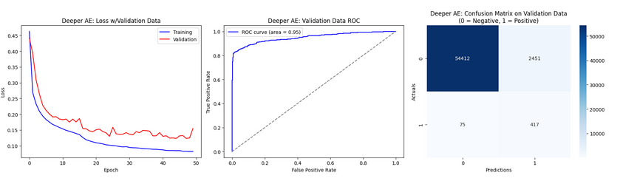
Test Set Performance Comparison (single vs deeper)
Notes:
The single-layer autoencoder achieved strong fraud detection with a ROC-AUC of 0.96 and a recall of 88.4%, successfully identifying most fraudulent transactions. However, its precision was low (~15%), indicating a high false positive rate. This makes it a strong baseline, but further tuning is needed to reduce false alarms.

Slide 8
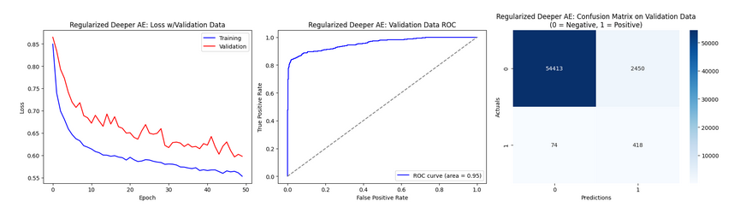
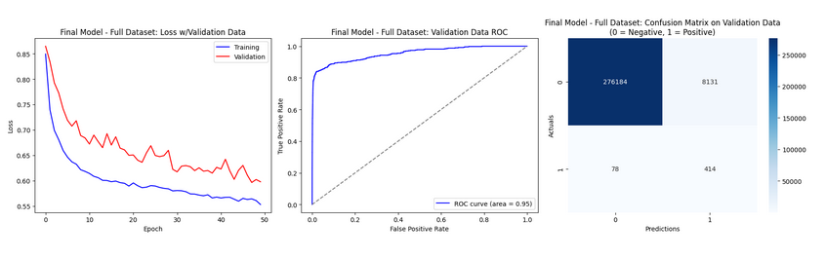
Test Set Performance Comparison contd.. Regularized and full dataset
Notes:
The deeper autoencoder demonstrated improved learning capacity, with lower training and validation loss compared to the single-layer model. It achieved a strong ROC-AUC of 0.95 and detected 84.7% of fraud cases. However, precision remained low (~14.5%), similar to the simpler model, indicating persistent false positives. While deeper layers improved reconstruction, they slightly reduced fraud recall and still require tuning for better precision.
While the model showed improved training stability and loss behavior, it did not significantly enhance precision or recall compared to the non-regularized version. The false positive rate remained high, suggesting regularization alone wasn't sufficient to improve detection quality.
When tested on the full dataset of 284,807 transactions, the final Single-Layer Autoencoder achieved a strong ROC-AUC of 0.95 and successfully detected 85.4% of fraudulent cases. However, precision dropped to just 3%, resulting in a high number of false positives (~13,800). While the model effectively identifies fraud, threshold tuning or post-processing is needed to reduce false alarms for practical deployment.

Slide 9
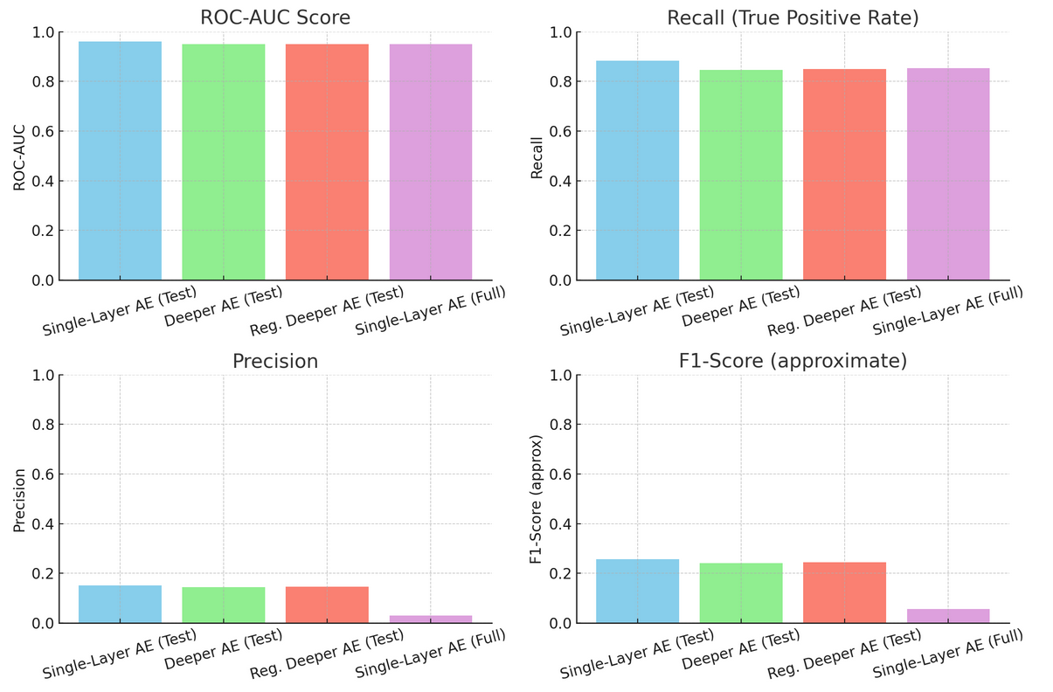
Model Performance Comparison Chart
Notes:
The Single-Layer Autoencoder delivered the highest recall (88.4%) and ROC-AUC (0.96), indicating excellent fraud detection ability and discrimination between classes. It achieved an F1-score of 0.257, outperforming both deeper models. However, precision remained low (~15%), with over 2,400 false positives. The Deeper Autoencoder improved training and validation loss but slightly underperformed in recall (84.7%) and F1. Adding Dropout and L2 regularization in the Regularized Deeper AE reduced overfitting, as seen in loss curves, but didn’t significantly improve fraud detection metrics. Across all models, false positives were high — a common challenge in highly imbalanced datasets — suggesting that additional threshold tuning or hybrid models may be needed.

Slide 10
Final Model on Full Dataset
• Evaluated Single-Layer AE on 284,807 transactions
• ROC-AUC: 0.95 | Recall: 85.4% | Precision: 2.96% | F1: 0.057
• Detected 420/492 fraud cases
• High false positives (13,821) due to class imbalance

Slide 11
Conclusion
• Single-Layer AE provided best detection with highest ROC-AUC and recall
• Deeper and regularized models helped reduce overfitting but didn't boost recall or precision
• All models showed low precision due to class imbalance — further post-processing needed
Notes:
In conclusion, autoencoders—especially simple ones—offer a powerful baseline for fraud detection, capable of high recall and strong discrimination using only unsupervised learning. With further enhancements such as threshold tuning, ensemble filtering, or human-in-the-loop validation, they can form a reliable foundation in financial fraud monitoring systems. The results of this project validate that even minimal architectures can yield strong detection performance when aligned with thoughtful design and evaluation strategies.

Slide 12
Future Recommendations
Tune thresholds more aggressively (97–99.9 percentile)
1
Add a secondary classifier for high-error samples
2
Explore temporal models (e.g., LSTM autoencoders)
3
Deploy in a feedback loop for continual improvement
4
Notes:
While the current autoencoder-based approach has demonstrated strong potential in detecting credit card fraud, several enhancements can be explored to improve precision and overall system robustness. First, adaptive thresholding or dynamic percentile-based thresholds could be implemented to adjust sensitivity based on transaction volume or risk score distribution. Additionally, incorporating a two-stage model—where flagged anomalies from the autoencoder are passed to a supervised classifier (e.g., XGBoost or Random Forest)—may help filter out false positives more effectively.

